Slide 1
PROJECT 26
Design and Implementation of a Database Management System for Student Attendance and Leave Approval
A relational database and reporting system covering course-wise attendance, leave applications, approvals, makeup sessions, and shortage alerts.
ER Modelling
3NF Normalization
SQL & PL Reports
Java / Python Front-End
Database Design Project | MySQL

Slide 2
INTRODUCTION
Problem Identification & Scope
Scope Covers
!
The Problem
1
Course-wise Attendance
Per-session attendance capture for every student, course and section.
Institutions must track course-wise attendance, process leave approvals, schedule makeup sessions, and flag attendance shortages. Manual consolidation across spreadsheets and paper registers is slow, inconsistent, and error-prone, leaving faculty and administrators without a reliable, real-time view of student attendance.
2
Leave Approval Workflow
Leave applications, leave types, and authorized faculty approvals.
3
Makeup Sessions
Proposed Solution
Scheduling and recording of compensatory class sessions.
A normalized relational database (3NF) with a Java/Python front-end that automates session creation, attendance marking, leave workflows, makeup entry, percentage calculation, and reporting.
Shortage Alerts
4
Automatic flags when attendance percentage drops below threshold.
Student Attendance & Leave Approval System
2

Slide 3
REQUIREMENTS
Objectives, User Roles & Functional Requirements
Model
Normalize
Implement
Report
Identify entities, attributes, relationships & roles
Convert ER model to a 3NF relational schema
Build the schema with constraints & sample data
Deliver SQL reports and a working front-end
User Roles
Key Functional Requirements
Student
Create courses, sections and class sessions
S
Views timetable, applies for leave, tracks attendance %
Mark and update attendance per student, per session
Faculty
Submit, review and approve/reject leave applications
F
Creates sessions, marks attendance, approves/rejects leave
Schedule and record makeup session attendance
Compute attendance percentage and raise shortage alerts
A
Admin / HOD
Manages courses, sections, users & consolidated reports
Generate joins, aggregate, nested-query and view-based reports
Student Attendance & Leave Approval System
3

Slide 4
CONCEPTUAL DESIGN
Principal Entities of the System
Student
Course
Section
Faculty
Learner enrolled in courses & sections
Subject offered by the institution
A scheduled offering of a course
Instructor teaching sections
Class Session
Attendance
Leave Type
Application
One scheduled meeting of a section
Student status for a class session
Category of leave (medical, personal…)
Student's leave request
Approval
Makeup Session
Alert
Faculty decision on an application
Compensatory session for missed classes
Notification of attendance shortage
Student Attendance & Leave Approval System
4

Slide 5
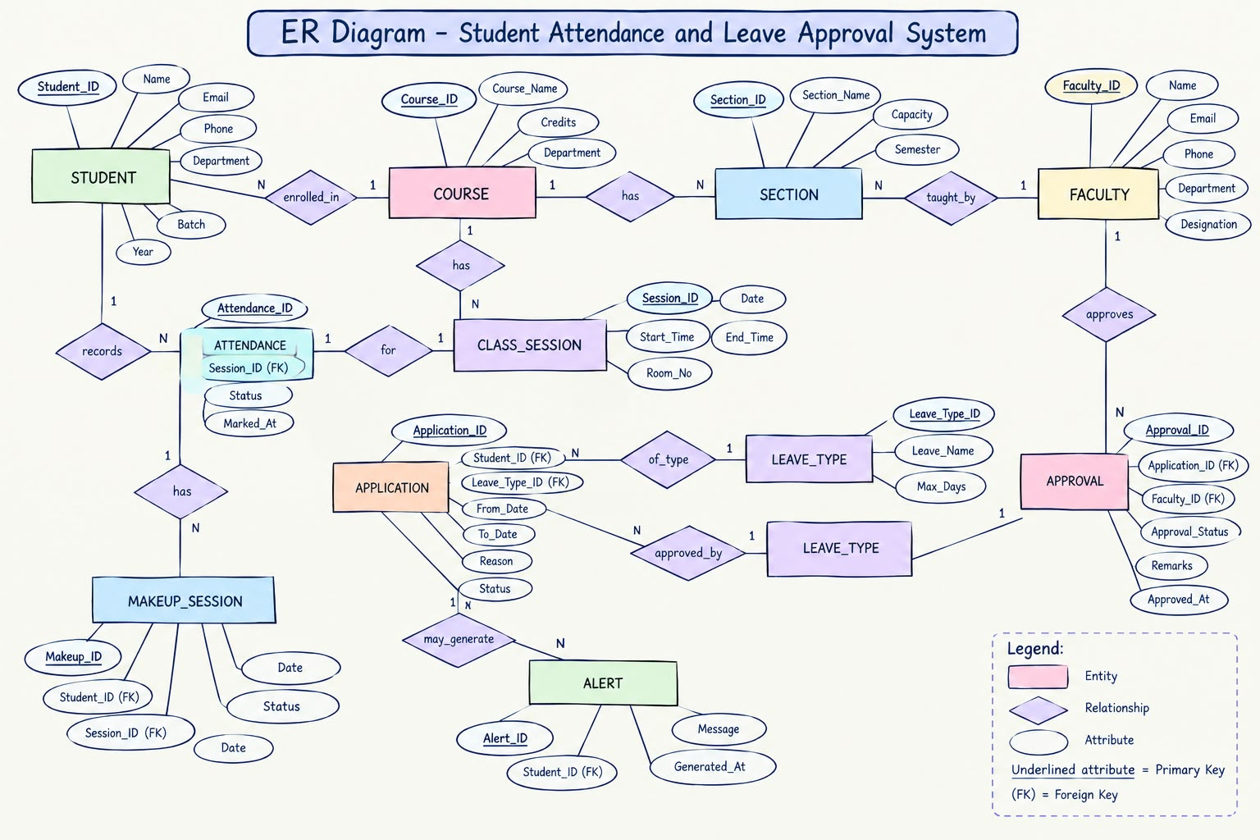
CONCEPTUAL DESIGN
Entity–Relationship Diagram
connects related entities • PK = primary key • FK = foreign key
Student Attendance & Leave Approval System
5

Slide 6
LOGICAL DESIGN
Initial Relational Schema (3NF)
Student
Faculty
Course
Key: student_id PK
Key: faculty_id PK
Key: course_id PK
Fields: name, email, program, dept_id FK
Fields: name, dept_id FK, email, phone
Fields: course_code UQ, title, credits
Section
Class_Session
Attendance
Key: section_id PK
Key: session_id PK
Key: attendance_id PK
Fields: course_id FK, faculty_id FK, term, room
Fields: section_id FK, session_date, start_time
Fields: student_id FK, session_id FK, status, marked_at
Leave_Type
Leave_Application
Approval
Key: leave_type_id PK
Key: application_id PK
Key: approval_id PK
Fields: type_name UQ, max_days_per_term
Fields: student_id FK, leave_type_id FK, from_date, to_date
Fields: application_id FK, faculty_id FK, decision, decided_at
Makeup_Session
Alert
Key: makeup_id PK
Key: alert_id PK
Fields: session_id FK, student_id FK, makeup_date, status
Fields: student_id FK, alert_type, attendance_pct, created_at
Student Attendance & Leave Approval System
6

Slide 7
DATA INTEGRITY
Business Rules & Constraints
Core Business Rules
Enforced Through
Exactly one attendance record per student per class session
PRIMARY KEY
Uniquely identifies every row in each table
Attendance status limited to a fixed set of valid codes (P/A/L/MU)
FOREIGN KEY
Preserves referential integrity across relationships
UNIQUE
Prevents duplicate course codes, leave types, sessions
Leave application dates must be valid and from_date ≤ to_date
NOT NULL
Guarantees mandatory fields are always supplied
Only an authorized faculty member may approve or reject a leave
CHECK
Restricts status codes, date ranges and percentages
Attendance percentage must fall within the 0–100 range
DEFAULT
Auto-fills status and timestamp fields on insert
Student Attendance & Leave Approval System
7

Slide 8
QUERYING & ANALYTICS
SQL Retrieval, Views & Reports
Query Techniques Demonstrated
Reports Generated
Multi-table JOINs
Attendance Percentage
Shortage List
Aggregate functions (COUNT, AVG, SUM)
Per student, per course attendance %
Students below the minimum attendance threshold
Nested / correlated subqueries
Reusable VIEWS for reporting
Leave History
Course Summary
GROUP BY & HAVING for summaries
Chronological leave applications & decisions
Session counts and average attendance by course
Date-based filtering & ranges
Monthly Trends
Makeup Attendance
SELECT s.name, ROUND(100.0 *
SUM(CASE WHEN a.status='P' THEN 1 ELSE 0 END)
/ COUNT(*), 2) AS attendance_pct
FROM Student s JOIN Attendance a USING (student_id)
GROUP BY s.student_id HAVING attendance_pct < 75;
Attendance trend across the academic term
Compensatory sessions attended per student
Student Attendance & Leave Approval System
8

Slide 9
IMPLEMENTATION
Front-End Application & Engineering Quality
Front-End Capabilities (Java / Python)
Engineering Quality Focus
Session creation
Attendance marking
Normalization
Schema decomposed and verified to Third Normal Form
Leave submission
Leave approval
Transaction Awareness
Commit/rollback around approval & attendance writes
Indexing
Makeup entry
% calculation & reporting
Indexes on foreign keys and frequently searched columns
Input Validation
Front-end and CHECK-constraint level validation
Systematic Testing
Sample data seeded to test rules and edge cases
Student Attendance & Leave Approval System
9

Slide 10
PROJECT DELIVERABLES
Summary of Submission
01
Requirements Definition
Problem identification, scope, objectives, user roles and functional requirements.
02
Conceptual ER Design
ER diagram covering students, courses, sections, faculty, sessions, attendance, leave types, applications, approvals, makeup sessions and alerts.
03
Initial Relational Schema
Proposed tables with primary keys, foreign keys and relationships, ready for 3NF normalization.
Database: MySQL • Front-End: Java or Python

